Slide 1
Main memory

Slide 2
Outline
In this lesson, we will:
Describe the purpose of main memory
Explain how each byte has its own address
See how these addresses are passed in parallel to main memory
This limits the maximum amount of memory that can be accessed
See how main memory is used for executing programs
See how main memory is used for storing local arrays

Slide 3
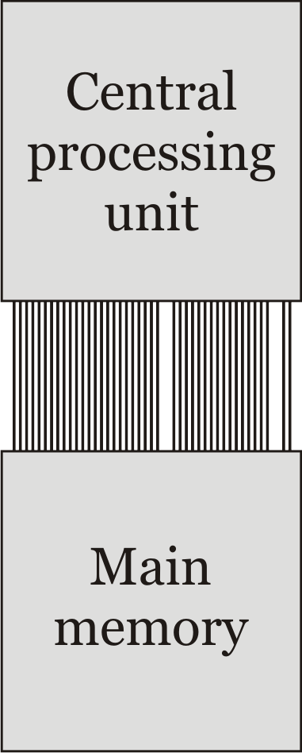
Main memory
Programs are stored in persistent memory
While a program is running,
the program requires temporary memory to execute
Long term memory can be slow,
but memory required during execution must be relatively fast
Main memory provides temporary
memory that can be accessed
The central processing unit (cpu)
communicates with main memory

Slide 4
Main memory
To access main memory:
Each byte in main memory has a unique address
The cpu sends an address and either flags to either:
Retrieve the value of the byte at that address
Set the byte at that address to a specific value

Slide 5
Main memory
0 | 00000000
1 | 00000000
2 | 00000000
3 | 00000000
4 | 00000000
5 | 00000000
6 | 00000000
7 | 00000000
8 | 00000000
9 | 00000000
10 | 00000000
11 | 00000000
12 | 00000000
13 | 00000000
14 | 00000000
15 | 00000000
16 | 00000000
17 | 00000000
18 | 00000000
19 | 00000000
20 | 00000000
21 | 00000000
22 | 00000000
23 | 00000000
24 | 00000000
25 | 00000000
26 | 00000000
27 | 00000000
⋮ | ⋮
53433 | 00000000
Okay, so each byte has its own address
This is called byte-addressable
If you want to change just one bit,
you must use the bit-wise and
bit-shift operators on a byte

Slide 6
Main memory
0 | 00000000
1 | 00000000
10 | 00000000
11 | 00000000
100 | 00000000
101 | 00000000
110 | 00000000
111 | 00000000
1000 | 00000000
1001 | 00000000
1010 | 00000000
1011 | 00000000
1100 | 00000000
1101 | 00000000
1110 | 00000000
1111 | 00000000
10000 | 00000000
10001 | 00000000
10010 | 00000000
10011 | 00000000
10100 | 00000000
10101 | 00000000
10110 | 00000000
10111 | 00000000
11000 | 00000000
11001 | 00000000
11010 | 00000000
11011 | 00000000
⋮ | ⋮
1101000010111001 | 00000000
Next, since we are in binary:
Each address will be a binary number

Slide 7
Serial versus parallel communication
If you read a 10 digit number to a friend,
you are communicating serially; one digit at a time
Also, you must know when you’re starting and stopping
If you and nine friends each communicates one of those digits to one of ten corresponding friends,
you are communicating in parallel; all ten digits at once
The first is cheaper, the second is faster
The communication between the cpu and main memory is parallel
A bus of n lines has each line carrying one bit of an address

Slide 8
Addresses
In a computer,
an address bus has n lines, each sending a 0 or a 1
This allows 2^{n} different addresses
The Intel 386 was the first common cpu with a 32-bit address bus
32 wires connected the cpu and main memory carrying the address
The first common cpu with a 64-bit addresses was the Nintendo 64
64 wires connected the cpu and main memory carrying the address
Incidentally, the Commodore 64 had 64 KiB of main memory
64 KiB = 2¹⁶ bytes
This could be addressed with a 16-bit address

Slide 9
Addresses
If every byte has its own address, then
A 32-bit address can uniquely address 2³² = 4 GiB
A 64-bit address can uniquely address 2⁶⁴ = 67 108 864 TiB
The restriction of 32-bit computers to accessing only 4 GiB of main memory led to the general adoption of 64-bit computers

Slide 10
Addresses
00000000000000000000000000000000 | 00000000
00000000000000000000000000000001 | 00000000
00000000000000000000000000000010 | 00000000
00000000000000000000000000000011 | 00000000
00000000000000000000000000000100 | 00000000
00000000000000000000000000000101 | 00000000
00000000000000000000000000000110 | 00000000
00000000000000000000000000000111 | 00000000
00000000000000000000000000001000 | 00000000
00000000000000000000000000001001 | 00000000
00000000000000000000000000001010 | 00000000
00000000000000000000000000001011 | 00000000
00000000000000000000000000001100 | 00000000
00000000000000000000000000001101 | 00000000
00000000000000000000000000001110 | 00000000
00000000000000000000000000001111 | 00000000
00000000000000000000000000010000 | 00000000
00000000000000000000000000100001 | 00000000
00000000000000000000000000100010 | 00000000
00000000000000000000000000100011 | 00000000
00000000000000000000000000100100 | 00000000
00000000000000000000000000100101 | 00000000
00000000000000000000000000100110 | 00000000
00000000000000000000000000100111 | 00000000
00000000000000000000000000101000 | 00000000
00000000000000000000000000101001 | 00000000
00000000000000000000000000101010 | 00000000
00000000000000000000000000101011 | 00000000
⋮ | ⋮
11111111111111111111111111111111 | 00000000
We could thus display all addresses by showing all 32 bits

Slide 11
Addresses
00000000 | 00000000
00000001 | 00000000
00000002 | 00000000
00000003 | 00000000
00000004 | 00000000
00000005 | 00000000
00000006 | 00000000
00000007 | 00000000
00000008 | 00000000
00000009 | 00000000
0000000a | 00000000
0000000b | 00000000
0000000c | 00000000
0000000d | 00000000
0000000e | 00000000
0000000f | 00000000
00000010 | 00000000
00000011 | 00000000
00000012 | 00000000
00000013 | 00000000
00000014 | 00000000
00000015 | 00000000
00000016 | 00000000
00000017 | 00000000
00000018 | 00000000
00000019 | 00000000
0000001a | 00000000
0000001b | 00000000
⋮ | 00000000
ffffffff | 00000000
Recall, however, that we can represent four bits with one hexadecimal digit
By convention, we will
Leave off leading zeros
Use ellipsis for intermediate fs
For example,
a310 instead of 0000a310
f⋯fb08 instead of fffffb08
If we are obviously discussing addresses, we may leave off the 0x

Slide 12
Addresses
Thus, given this 32-bit address,
0b11110101011011100001010101011110
we could write it as
0xf56e155e
Similarly, given this 64-bit address in hexadecimal:
0x0003a58f293e5b80
we could determine the bits
0b0000000000000011101001011000111100101001001111100101101110000000

Slide 13
Main memory
0x00000000
Thus, we could visualize all of main memory as shown here
Assume this is a 32-bit computer with 4 GiB of main memory
0xffffffff

Slide 14
Main memory
0x00000000
When a program is executed,
the operating system allocates some block
of memory for its execution
0x70000000
Top of memory
Bottom of memory
0x7fffffff
0xffffffff

Slide 15
Main memory
0x00000000
Top of memory
For the purpose of this course,
we will assume that the program has
access to all of memory
This is actually achievable with virtual memory
Bottom of memory
0xffffffff

Slide 16
Main memory
0x00000000
Code segment
The instructions are stored starting at the top of memory
This is called the code segment
0xffffffff

Slide 17
Main memory
0x00000000
Code segment
Literals are stored next in the data segment
Data segment
0xffffffff

Slide 18
Main memory
0x00000000
Code segment
Memory for local variables is stored starting at the bottom of memory
This is called the call stack
As we need more local variables, the call stack will grow towards the top of memory
Data segment
Call stack
0xffffffff

Slide 19
Main memory
0x00000000
Code segment
The remaining memory between the data segment and the call stack will be used for additional features:
Local variables that keep their value between function calls (static)
Dynamically allocated memory (the heap)
Data segment
Call stack
0xffffffff

Slide 20
Local arrays
⋮ | ⋮
ffff3d7f | 00000000
ffff3d80 | 00000000
ffff3d81 | 00000000
ffff3d82 | 00000000
ffff3d83 | 00000000
ffff3d84 | 00000000
ffff3d85 | 00000000
ffff3d86 | 00000000
ffff3d87 | 00000000
ffff3d88 | 00000000
ffff3d89 | 00000000
ffff3d8a | 00000000
ffff3d8b | 00000000
ffff3d8c | 00000000
ffff3d8d | 00000000
ffff3d8e | 00000000
ffff3d8f | 00000000
ffff3d90 | 00000000
ffff3d91 | 00000000
ffff3d92 | 00000000
ffff3d93 | 00000000
ffff3d94 | 00000000
⋮ | ⋮
Suppose we have this program:
#include <iostream>
int main();
int main() {
int data[5];
std::cout << data << std::endl;
return 0;
}
data[0]
data[1]
data[2]
data[3]
Output:
0xffff3d80
data[4]

Slide 21
Summary
Following this lesson, you now
Know that main memory is byte addressable and each byte has its own unique address
Know addresses are passed in parallel through an address bus with a fixed number of n lines or bits
Understand that this limits available main memory to 2^{n} bytes
Know that addresses are represented as hexadecimal digits
Understand that an executing program occupies a
Code segment
Data segment
Call stack
Are aware of how an array may be stored in main memory

Slide 22
References
[1] No references?

Slide 23
Colophon
These slides were prepared using the Georgia typeface. Mathematical equations use Times New Roman, and source code is presented using Consolas.
The photographs of lilacs in bloom appearing on the title slide and accenting the top of each other slide were taken at the Royal Botanical Gardens on May 27, 2018 by Douglas Wilhelm Harder. Please see
https://www.rbg.ca/
for more information.

Slide 24
Disclaimer
These slides are provided for the ece 150 Fundamentals of Programming course taught at the University of Waterloo. The material in it reflects the authors’ best judgment in light of the information available to them at the time of preparation. Any reliance on these course slides by any party for any other purpose are the responsibility of such parties. The authors accept no responsibility for damages, if any, suffered by any party as a result of decisions made or actions based on these course slides for any other purpose than that for which it was intended.

